Slide 1
Randomized Block Designs Assigning Clusters Within Blocks
Larry V. Hedges
Northwestern University
Presented at the NSF Institute on Improving the Design of Evaluation studies in STEM Education Research, July 21, 2021

Slide 2
Definition of Randomized Block Designs Assigning Clusters
Sometimes the sample comes in blocks, but it is not possible to assign individuals to treatments
The reasons might be conceptual, practical, or political
Conceptual: The intervention is a “whole class” intervention
Practical: It is too hard for different students to receive different treatments in the same classroom
Political: One treatment seems more desirable, parents or students will never agree to being randomized within a class (i.e., their children not getting the desirable treatment their peers get)

Slide 3
Definition of Randomized Block Designs Assigning Clusters
Sometimes this design is called the “multisite cluster randomized trial” because clusters are assigned to treatments withing sites

Slide 5
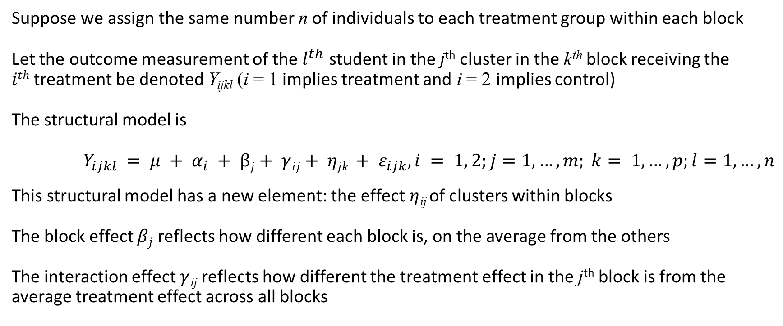
A Statistical Model
Suppose we assign the same number n of individuals to each treatment group within each block
Let the outcome measurement of the $l^{th}$ student in the j^{th} cluster in the k^{th} block receiving the $ith$treatment be denoted Y_{ijkl} (i = 1 implies treatment and i = 2 implies control)
The structural model is
$Y_{ijkl} = μ + α_{i} + βj+ γ{ij+ ηjk + ε}_{ijk}, i = 1, 2;j=1, …, m; k= 1, …, p;l=1, …, n$
This structural model has a new element: the effect$η$_{ij} of clusters within blocks
The block effect $βj$ reflects how different each block is, on the average from the others
The interaction effect $γ$_{ij} reflects how different the treatment effect in the j^{th} block is from the average treatment effect across all blocks

Slide 6
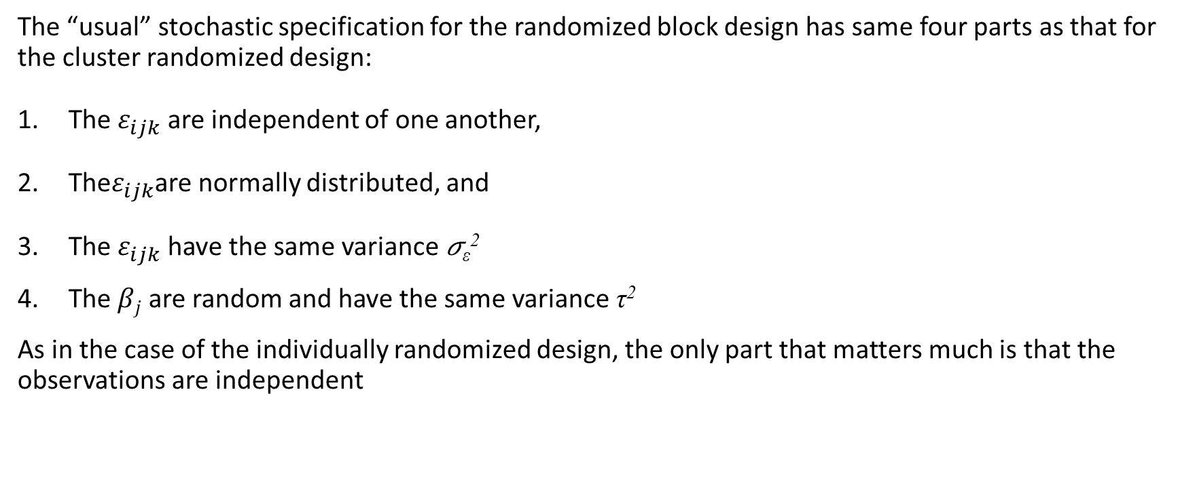
A Statistical Model
The “usual” stochastic specification for the randomized block design has same four parts as that for the cluster randomized design:
The $ε_{ijk}$ are independent of one another,
The$ε_{ijk}$are normally distributed, and
The $ε_{ijk}$have the same variance 𝜎_{ε}²
The $βj$ are random and have the same variance τ²
As in the case of the individually randomized design, the only part that matters much is that the observations are independent

Slide 7
We Have Given the Model for the Blocks-Fixed Analysis
There are two different statistical models for this design: One assumes blocks have fixed effects, the other assumes that blocks have random effects
The blocks-fixed analysis is more appropriate for initial field trials
This analysis limits its inferences to the blocks that were observed in the study

Slide 8
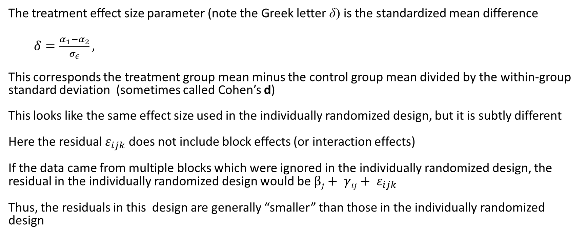
Effect Size
The treatment effect size parameter (note the Greek letter δ) is the standardized mean difference
$δ=\frac{α_{1}−α_{2}}{σ_{ε}},$
This corresponds the treatment group mean minus the control group mean divided by the within-group standard deviation (sometimes called Cohen’s d)
This looks like the same effect size used in the individually randomized design, but it is subtly different
Here the residual $ε_{ijk}$ does not include block effects (or interaction effects)
If the data came from multiple blocks which were ignored in the individually randomized design, the residual in the individually randomized design would be $βj+ γ{ij+ ε}_{ijk}$
Thus, the residuals in this design are generally “smaller” than those in the individually randomized design

Slide 9
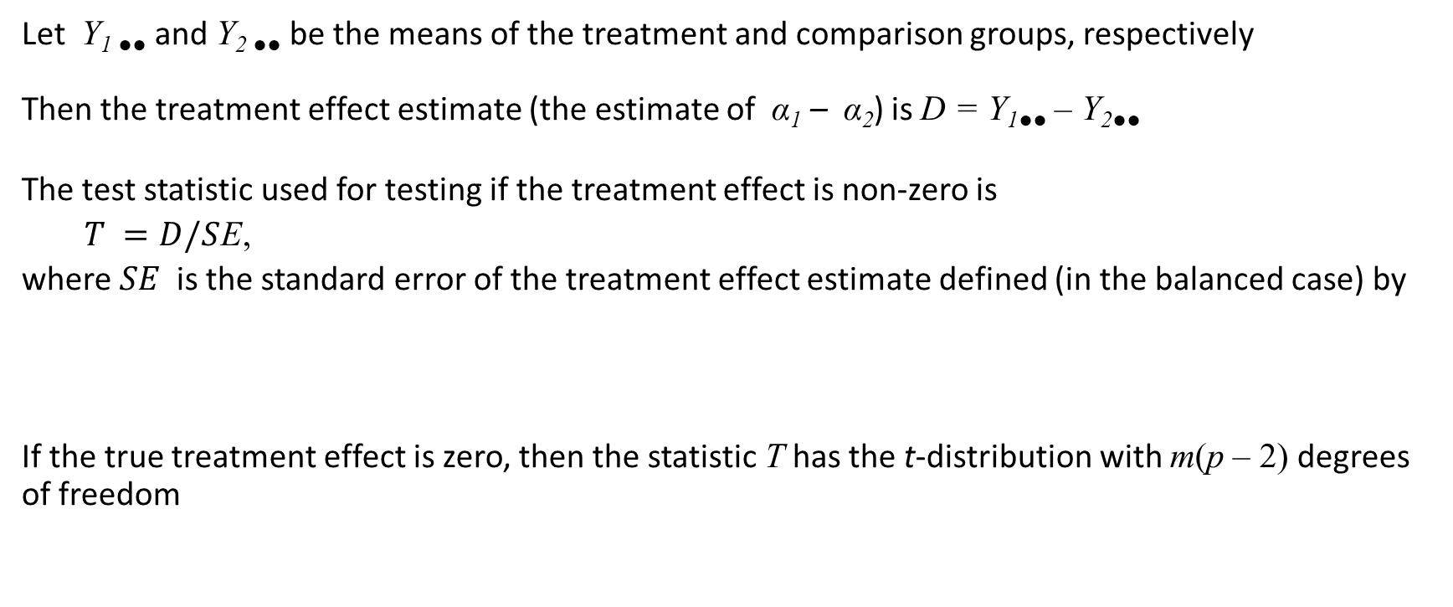
Testing the Significance of the Treatment Effect
Let Y_{1 ●●} and Y_{2 ●●} be the means of the treatment and comparison groups, respectively
Then the treatment effect estimate (the estimate of α₁ – α₂) is D = Y_{1●●} – Y_{2●●}
The test statistic used for testing if the treatment effect is non-zero is
$T =D/S$E,
where $SE$is the standard error of the treatment effect estimate defined (in the balanced case) by
If the true treatment effect is zero, then the statistic T has the t-distribution with m(p – 2) degrees of freedom

Slide 10
Testing the Significance of the Treatment Effect
The significance testing process involves
Picking a significance level (this is up to you, but 0.05 is conventional)
Computing the value of T from the data
Obtaining the critical value of the t-distribution with m(p – 2) degrees of freedom (which will be about 2 for the for all but the smallest degrees of freedom)
Reject the null hypothesis of no treatment effect (in other words conclude that the treatment effect is significant) if |T| exceeds the critical value
You could also use software that computes the “exact p-value.” In that method, conclude that the treatment effect is significant if the two-tailed p-value is less than 0.05

Slide 11
Design Sensitivity
Recall that design sensitivity can be described in any one of three related ways:
Statistical power
Precision (standard error) of the estimated treatment effect
The minimum detectable effect size (MDES)
We will discuss design sensitivity mainly through MDES
As a practical matter, design sensitivity for randomized block designs assigning clusters is limited primarily by the number of clusters (p) per block and the feasible number of blocks
We assume in this workshop that the number of blocks (schools) available is limited to 5 – 10 , rarely as many as 20, so that m = 5 – 10 is about the maximum number of clusters that are feasible
We also assume that the number of clusters (classrooms) per school is likely to be at most 5 – 6, so that the number of clusters per treatment condition is no more than 2 – 3

Slide 12
MDES in Randomized Block Designs Assigning Clusters
In randomized block designs assigning clusters, MDES depends on
1. The significance level (0.05 is a very strong convention)
2. The power level desired (0.8 is a strong convention)
The number m of blocks
The number p of clusters per block assigned to each treatment
The number of individuals n within each cluster
The within-block intraclass correlation ρ
The covariate outcome correlation R is covariates are used

Slide 13
MDES in Randomized Block Designs Assigning Clusters
MDES depends strongly on the number m of blocks
MDES depends strongly on the number p of clusters assigned to each treatment within blocks
MDES depends weakly on the number n of individuals in each cluster
Moreover, there is a point of diminishing returns in increasing n, MDES decreases less rapidly until it reaches an asymptote
MDES tends to some positive value even when n → ∞
Thus, total sample size n = 2mpn is a poor guide to design sensitivity
But remember that design sensitivity also depends on ρ, so understanding MDES in randomized block designs assigning clusters is a complex business

Slide 14
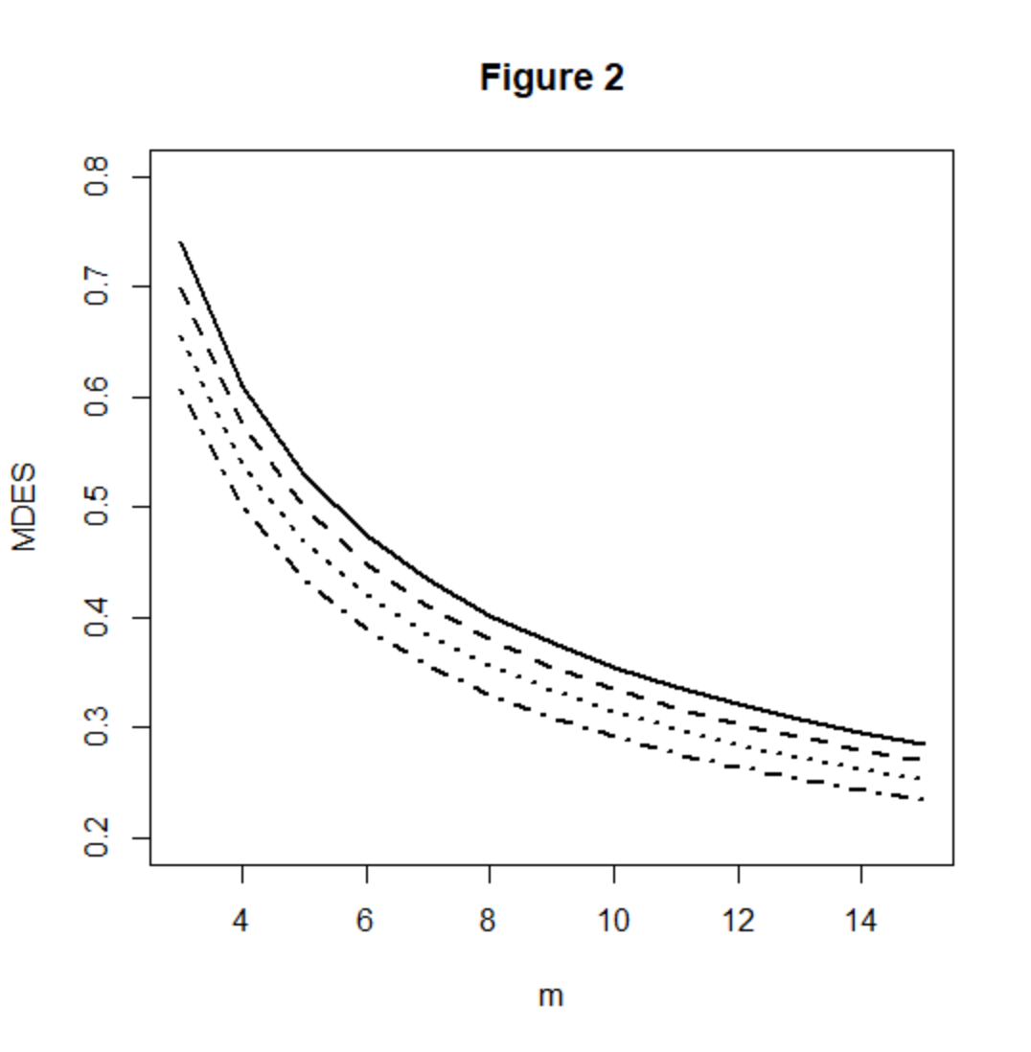
A Graphical Representation of MDES as Function of m p = 2
All figures have ρ = 0.05 and p = 2
n = 10 (solid line)
n = 12 (dashed line)
n = 15 (dotted line)
n = 20 (dashed and dotted line)

Slide 15
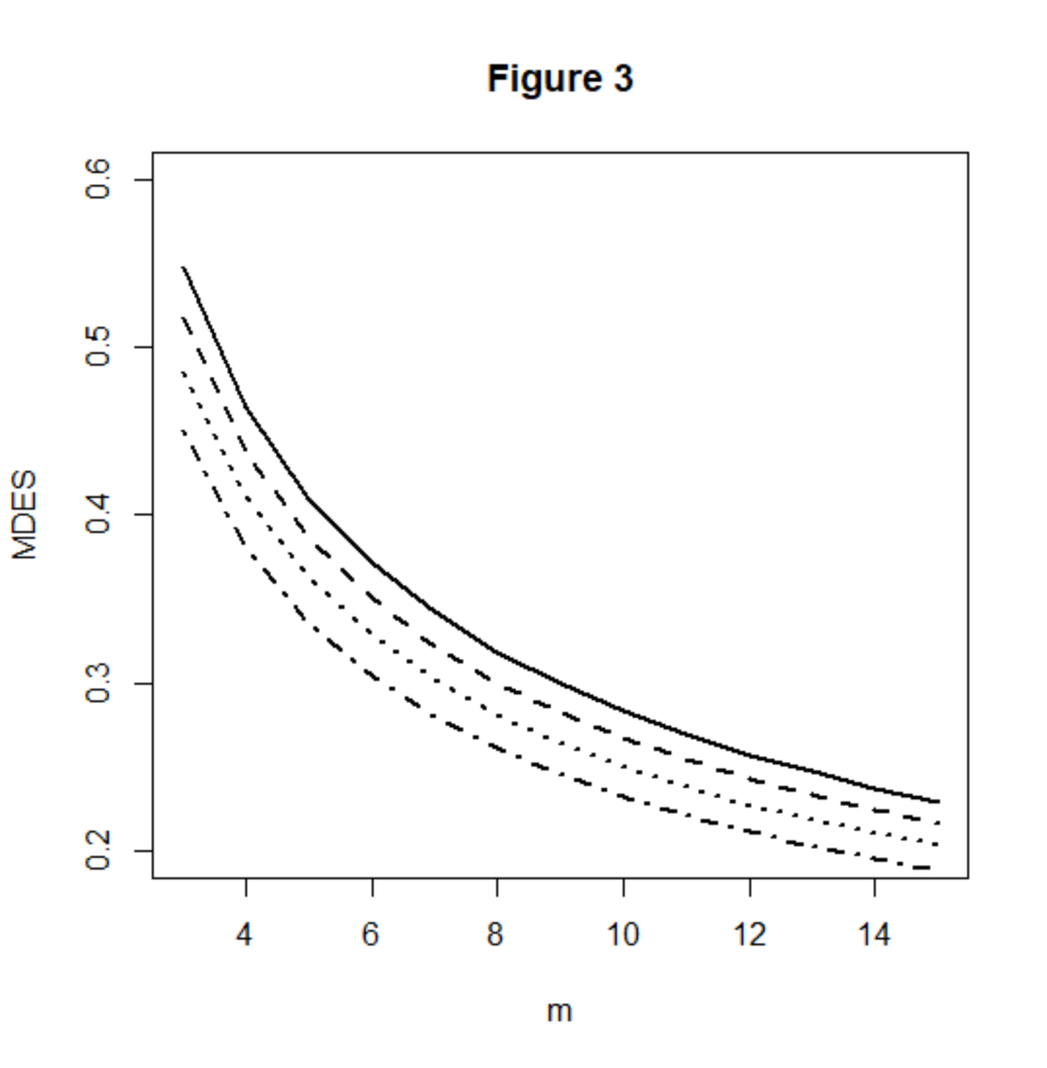
A Graphical Representation of MDES as Function of m p = 3
All figures have ρ = 0.05 and p = 2
n = 10 (solid line)
n = 12 (dashed line)
n = 15 (dotted line)
n = 20 (dashed and dotted line)

Slide 16
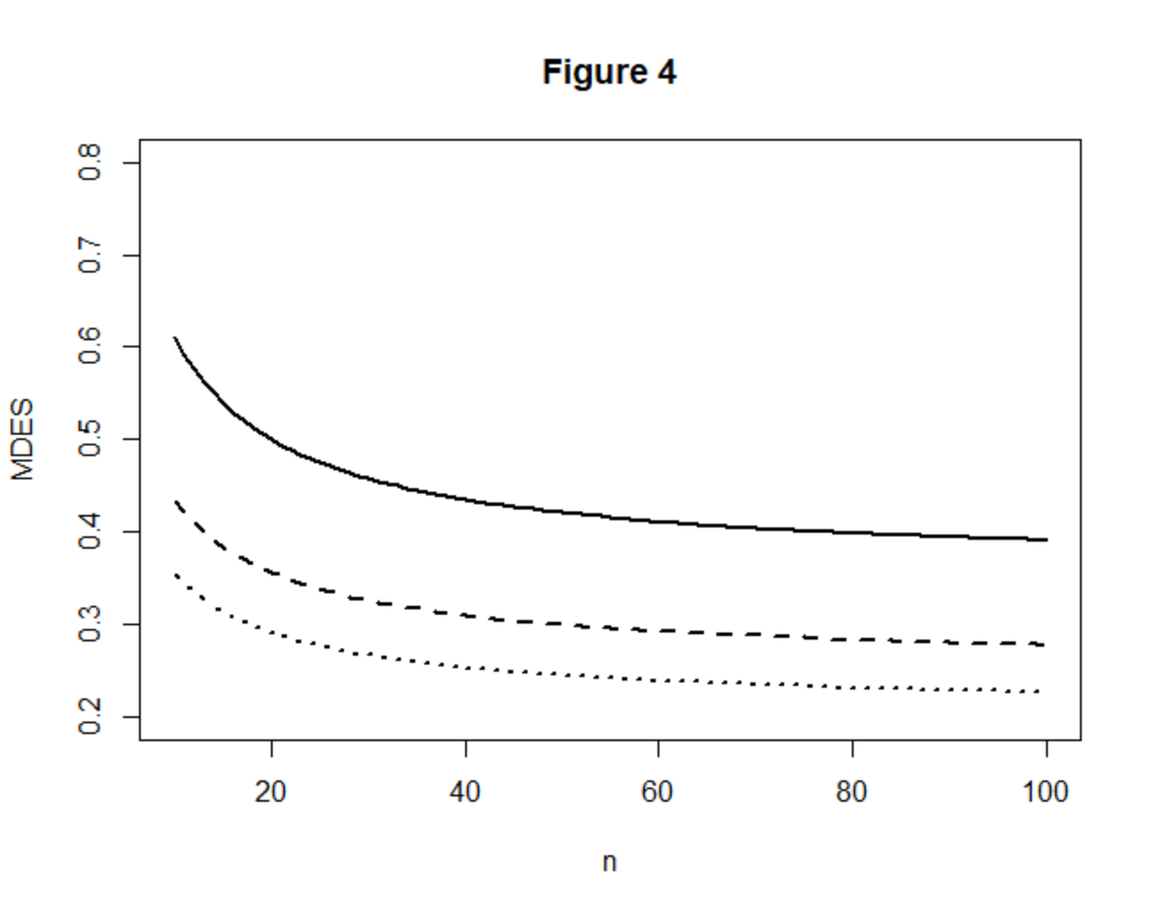
A Graphical Representation of MDES as Function of n p = 2
All figures have ρ = 0.05 and p = 2
m = 4 (solid line)
m= 7 (dashed line)
m= 10(dotted line)

Slide 17
MDES in this Design Depends on ρ
As in simple cluster randomized designs, design sensitivity depends on ρ because of the nature of two stage sampling
Recall the design effect idea. This design involves a two-stage cluster sample. Within each block. The fact that it is a cluster sample imposes a design effect involving ρ
One way of talking about this is that ρ (along with n) determines the “effective sample size”
The effective sample size in this design is somewhere between the number of clusters 2mp and the total sample size 2mpn, determined by the values of ρ and n
Effective sample size is

Slide 18
The Fundamental Problem of Research Design
The fundamental problem of research design is how to plan a feasible design that is adequately sensitive
If you have unlimited number of blocks or clusters, it is easy to get any design sensitivity you want
But we usually have a severely limited number of both blocks and clusters (m = 5 – 10, p = 1, 2, or 3)
In the easiest case, then you simply use a table like the one presented previously or a software tool and find the m for your n, p, and ρ that has an MDES that is smaller than the effect size you expect
Often, that number m of blocks or p of clusters is larger than the sample you believe you could get
What then?

Slide 19
Three Strategies to Improve Design Sensitivity
Three strategies can be used to improve design sensitivity:
Matching clusters before random assignment (this strategy should probably always be used in initial field trials)
Increase cluster size (but there are clear limits to class size)
Use of covariates (but this is unlikely to help much if you have matched)
Unbalanced designs using more control clusters than treatment clusters (p^{C} > p^{T})

Slide 20
Matching of Clusters Before Random Assignment
The sensitivity of randomized block designs assigning clusters can be increased substantially by matching clusters before random assignment
Matching clusters is easier than in cluster randomized designs because you only have to match within blocks before assignment (fewer items to match)
If a covariate is available (pretest scores of last year’s achievement test scores) it is possible to “tailor” clusters so that they match very closely on the covariate
Tailoring would involve dropping individuals from clusters (from the experiment not literally removing them) so that the covariate scores on the clusters are close to identical
Because the intraclass correlation is measured on the outcome, this will not make the intraclass correlation zero even if the average covariate scores match exactly
But matching on the covariate will make the intraclass correlation small: If the covariate-outcome correlation is 0.7, this can make the intraclass correlation ρ < 0.05

Slide 21
Increase Number of Clusters or Cluster Size
If clusters are classes, the number of clusters pre school is limited, but increasing the number of clusters greatly increases design sensitivity
Even increasing by one cluster per school can make a noticeable difference (even if that leads to on odd number of clusters per school and imbalance)
If clusters are classes, it may not be possible to increase the cluster size (more students per class) very much
However, if the intraclass correlation is small, we saw that increasing cluster size (up to a point) will increase design sensitivity

Slide 22
Adding Covariates
Note: If you matched clusters before random assignment, covariates will be less effective in increasing design sensitivity because matching reduces the covariate-outcome correlation at the cluster level

Slide 23
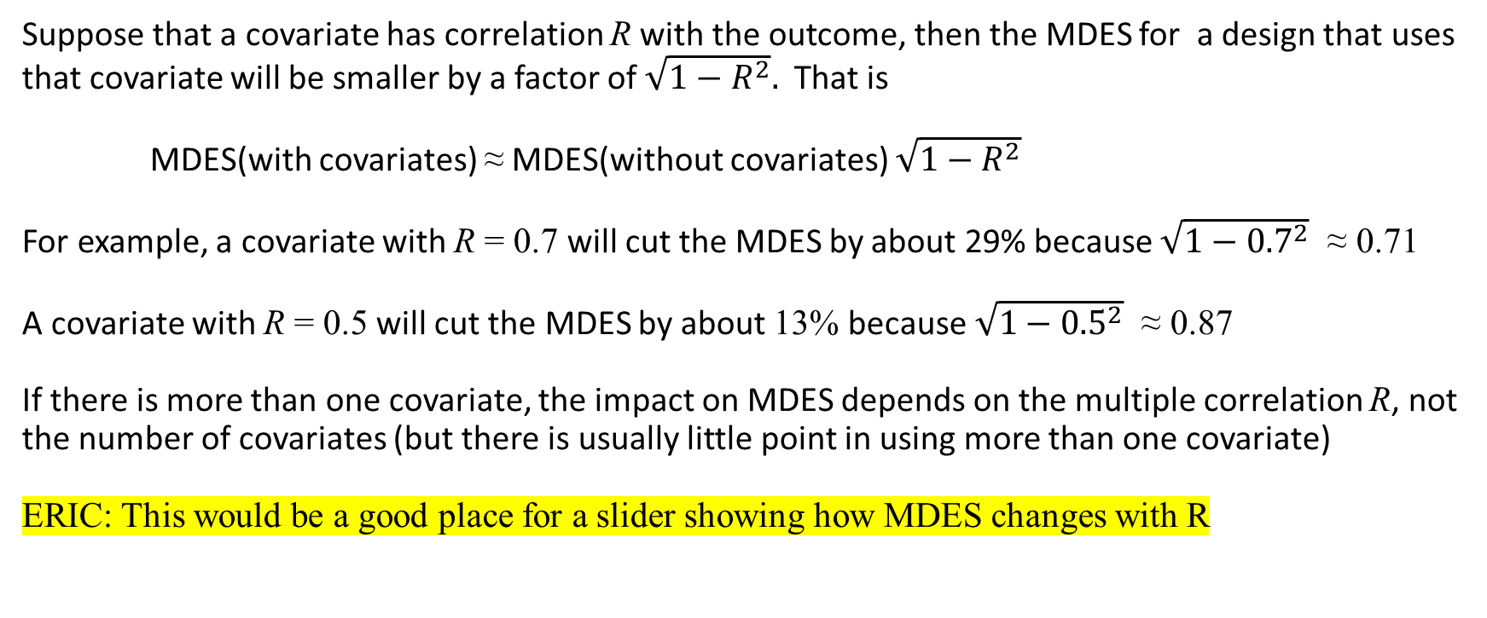
The Effect of Covariates on MDES
Suppose that a covariate has correlation R with the outcome, then the MDES for a design that uses that covariate will be smaller by a factor of $\sqrt{1−R^{2}}.$ That is
MDES(with covariates) ≈ MDES(without covariates) $\sqrt{1−R^{2}}$
For example, a covariate with R = 0.7 will cut the MDES by about 29% because $\sqrt{1−{0.7}^{2}}$ ≈ 0.71
A covariate with R = 0.5 will cut the MDES by about 13% because $\sqrt{1−{0.5}^{2}}$ ≈ 0.87
If there is more than one covariate, the impact on MDES depends on the multiple correlation R, not the number of covariates (but there is usually little point in using more than one covariate)
ERIC: This would be a good place for a slider showing how MDES changes with R

Slide 24
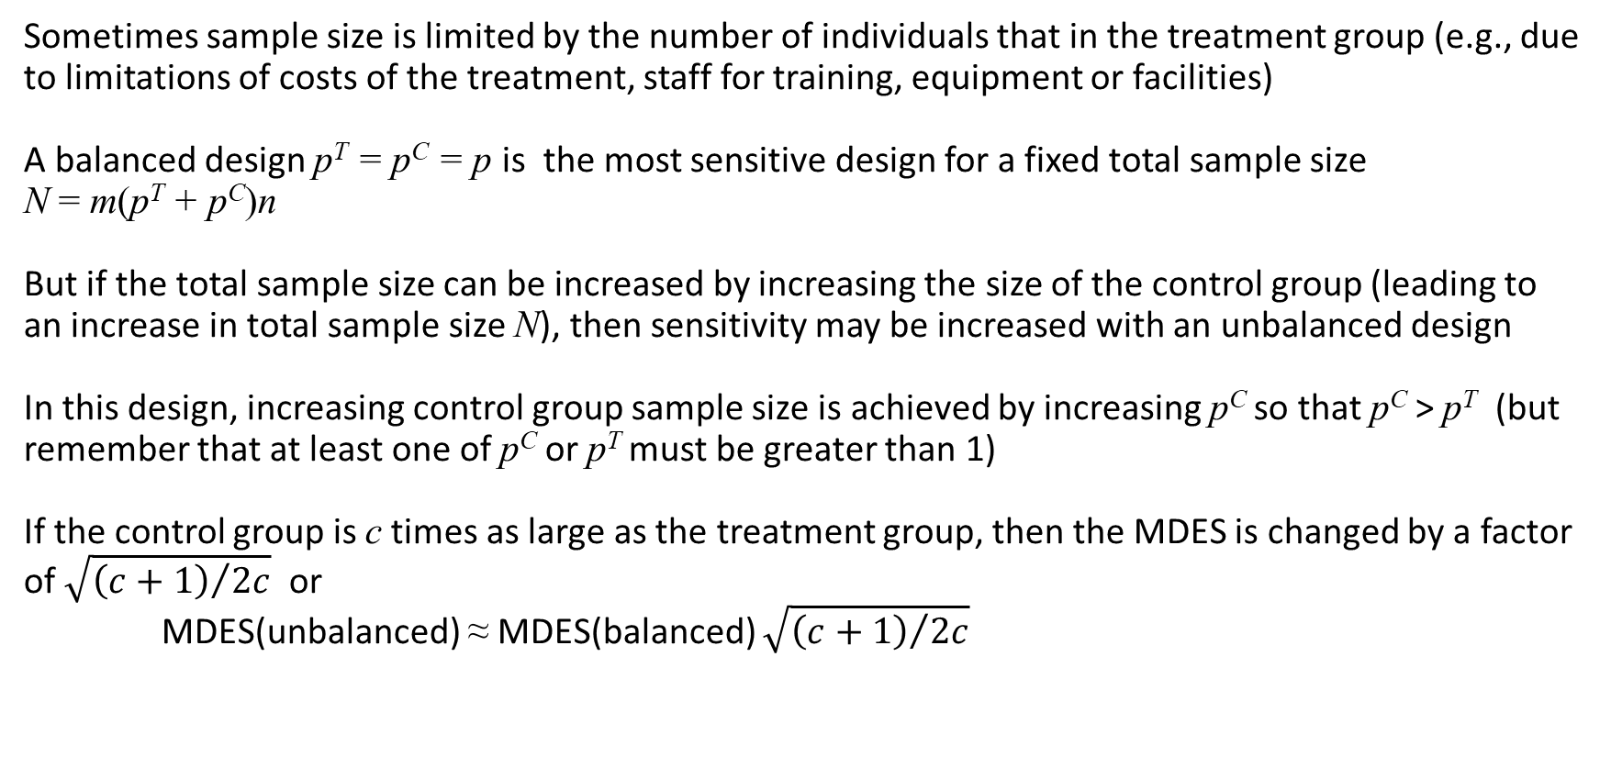
Unbalanced Designs
Sometimes sample size is limited by the number of individuals that in the treatment group (e.g., due to limitations of costs of the treatment, staff for training, equipment or facilities)
A balanced design p^{T} = p^{C} = p is the most sensitive design for a fixed total sample size N = m(p^{T} + p^{C})n
But if the total sample size can be increased by increasing the size of the control group (leading to an increase in total sample size N), then sensitivity may be increased with an unbalanced design
In this design, increasing control group sample size is achieved by increasing p^{C} so that p^{C} > p^{T} (but remember that at least one of p^{C} or p^{T} must be greater than 1)
If the control group is c times as large as the treatment group, then the MDES is changed by a factor of $\sqrt{{\left(c+1\right)}/{2c}}$ or
MDES(unbalanced) ≈ MDES(balanced) $\sqrt{{\left(c+1\right)}/{2c}}$

Slide 25
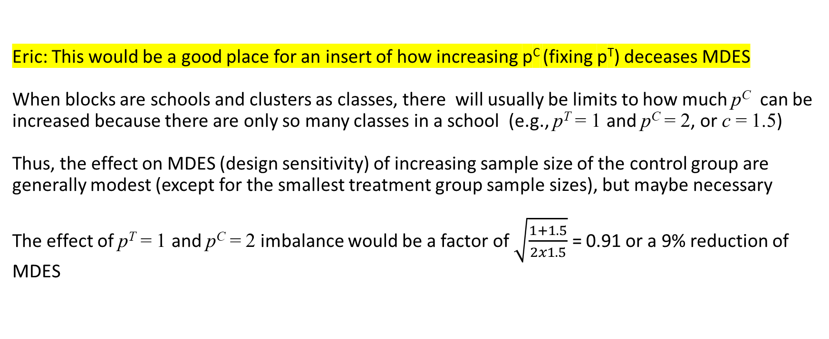
Unbalanced Designs
Eric: This would be a good place for an insert of how increasing p^{C} (fixing p^{T}) deceases MDES
When blocks are schools and clusters as classes, there will usually be limits to how much p^{C} can be increased because there are only so many classes in a school (e.g., p^{T} = 1 and p^{C} = 2, or c = 1.5)
Thus, the effect on MDES (design sensitivity) of increasing sample size of the control group are generally modest (except for the smallest treatment group sample sizes), but maybe necessary
The effect of p^{T} = 1 and p^{C} = 2 imbalance would be a factor of $\sqrt{\frac{1+1.5}{2x1.5}}$ = 0.91 or a 9% reduction of MDES

Slide 26
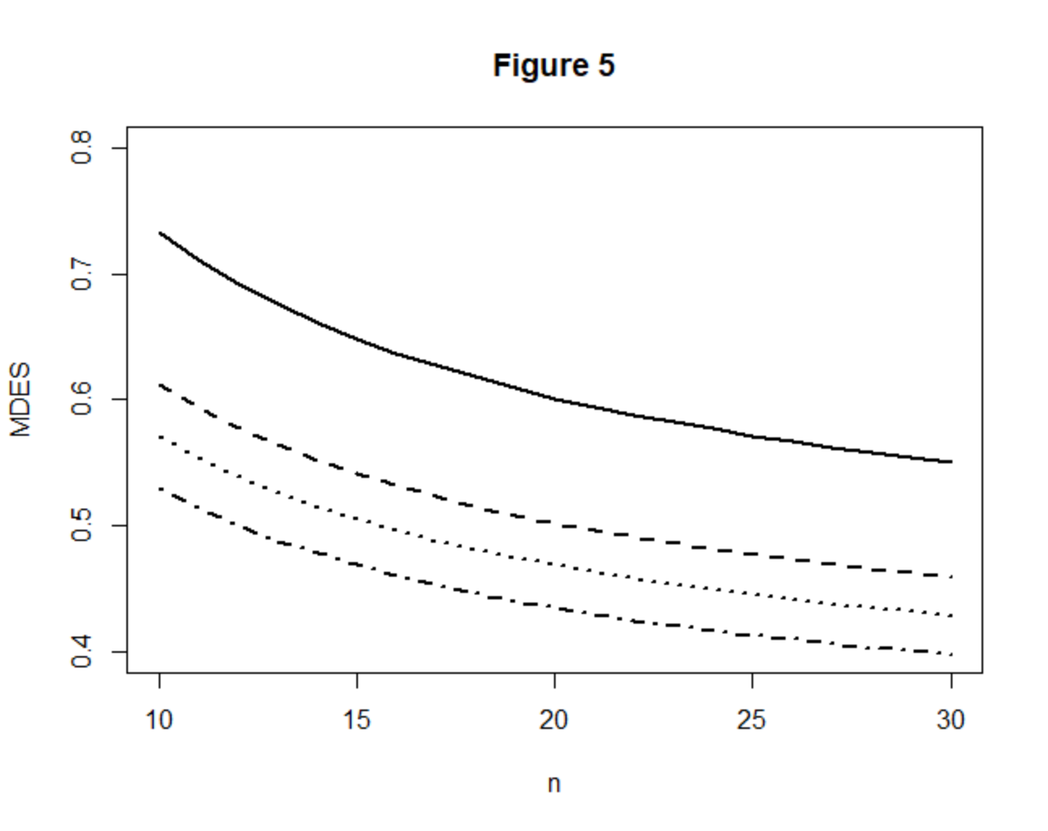
A Graphical Representation of MDES as Function of n for various values of p^{T} and p^{C}
In all figures m = 5, ρ = 0.05
p^{T} = 1, p^{C} = 2 (solid line)
p^{T} = 1, p^{C} = 3 (dashed line)
p^{T} = 2, p^{C} = 2 (dotted line)
p^{T} = 1, p^{C} = 4 (dash dotted line)

Slide 27
MDES as a Function of m and n when p^{T} = 1, p^{C} = 2 (ρ = 0.05)
 | n
m | 10 | 11 | 12 | 13 | 14 | 15 | 16 | 17 | 18 | 19 | 20 | 25
2 | 1.86 | 1.81 | 1.76 | 1.72 | 1.68 | 1.65 | 1.62 | 1.59 | 1.57 | 1.55 | 1.53 | 1.45
3 | 1.15 | 1.11 | 1.08 | 1.06 | 1.03 | 1.01 | 1.00 | 0.98 | 0.96 | 0.95 | 0.94 | 0.89
4 | 0.88 | 0.85 | 0.83 | 0.81 | 0.79 | 0.78 | 0.76 | 0.75 | 0.74 | 0.73 | 0.72 | 0.68
5 | 0.73 | 0.71 | 0.69 | 0.68 | 0.66 | 0.65 | 0.64 | 0.63 | 0.62 | 0.61 | 0.60 | 0.57
6 | 0.64 | 0.62 | 0.61 | 0.59 | 0.58 | 0.57 | 0.56 | 0.55 | 0.54 | 0.53 | 0.53 | 0.50
7 | 0.58 | 0.56 | 0.54 | 0.53 | 0.52 | 0.51 | 0.50 | 0.49 | 0.49 | 0.48 | 0.47 | 0.45
8 | 0.53 | 0.51 | 0.50 | 0.49 | 0.48 | 0.47 | 0.46 | 0.45 | 0.44 | 0.44 | 0.43 | 0.41
9 | 0.49 | 0.48 | 0.46 | 0.45 | 0.44 | 0.43 | 0.43 | 0.42 | 0.41 | 0.41 | 0.40 | 0.38
10 | 0.46 | 0.44 | 0.43 | 0.42 | 0.41 | 0.41 | 0.40 | 0.39 | 0.39 | 0.38 | 0.38 | 0.36
11 | 0.43 | 0.42 | 0.41 | 0.40 | 0.39 | 0.38 | 0.38 | 0.37 | 0.36 | 0.36 | 0.35 | 0.34
12 | 0.41 | 0.40 | 0.39 | 0.38 | 0.37 | 0.36 | 0.36 | 0.35 | 0.35 | 0.34 | 0.34 | 0.32
13 | 0.39 | 0.38 | 0.37 | 0.36 | 0.35 | 0.35 | 0.34 | 0.34 | 0.33 | 0.33 | 0.32 | 0.31
14 | 0.38 | 0.36 | 0.35 | 0.35 | 0.34 | 0.33 | 0.33 | 0.32 | 0.32 | 0.31 | 0.31 | 0.29
15 | 0.36 | 0.35 | 0.34 | 0.33 | 0.33 | 0.32 | 0.31 | 0.31 | 0.30 | 0.30 | 0.30 | 0.28

